Slide 1
Data Preprocessing
Cleaning
Augmentation
Visualization
Transformation
Feature Extraction

Slide 2

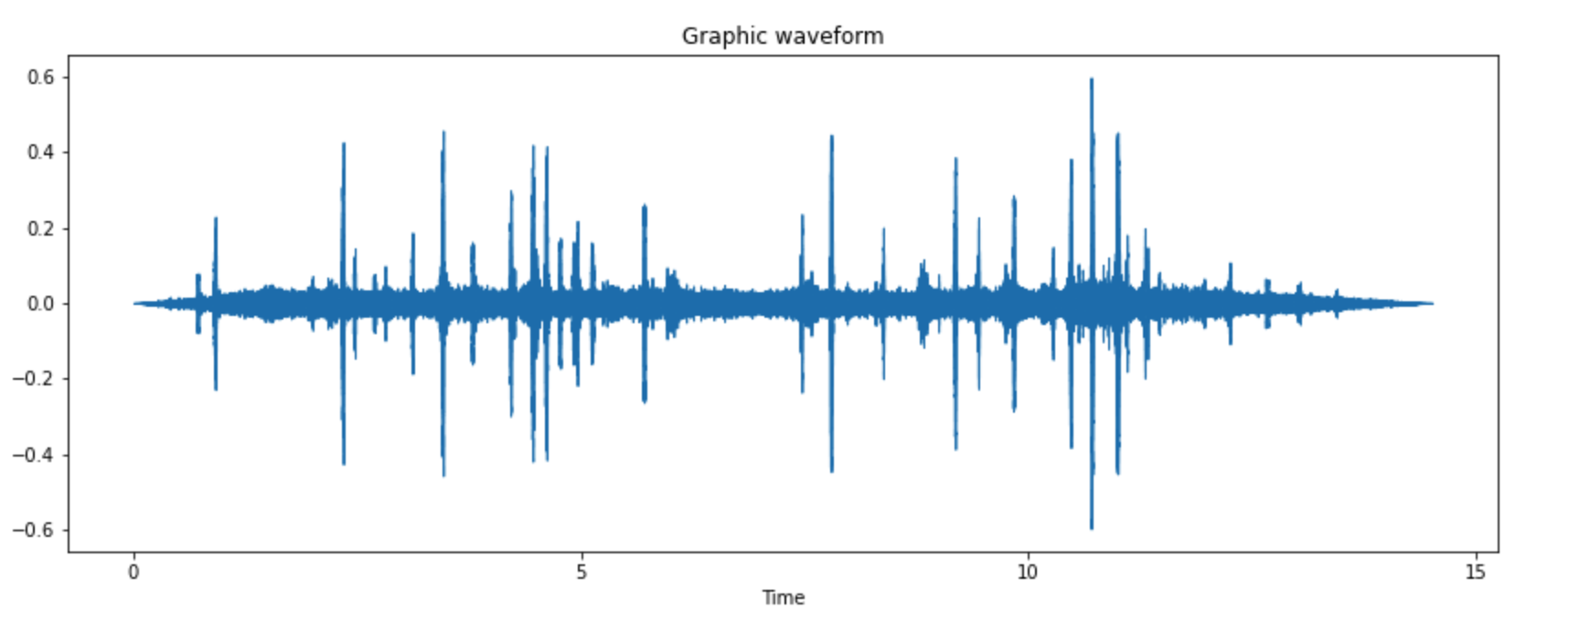
Data visualization
Sample input audio
Graphic waveform

Slide 3
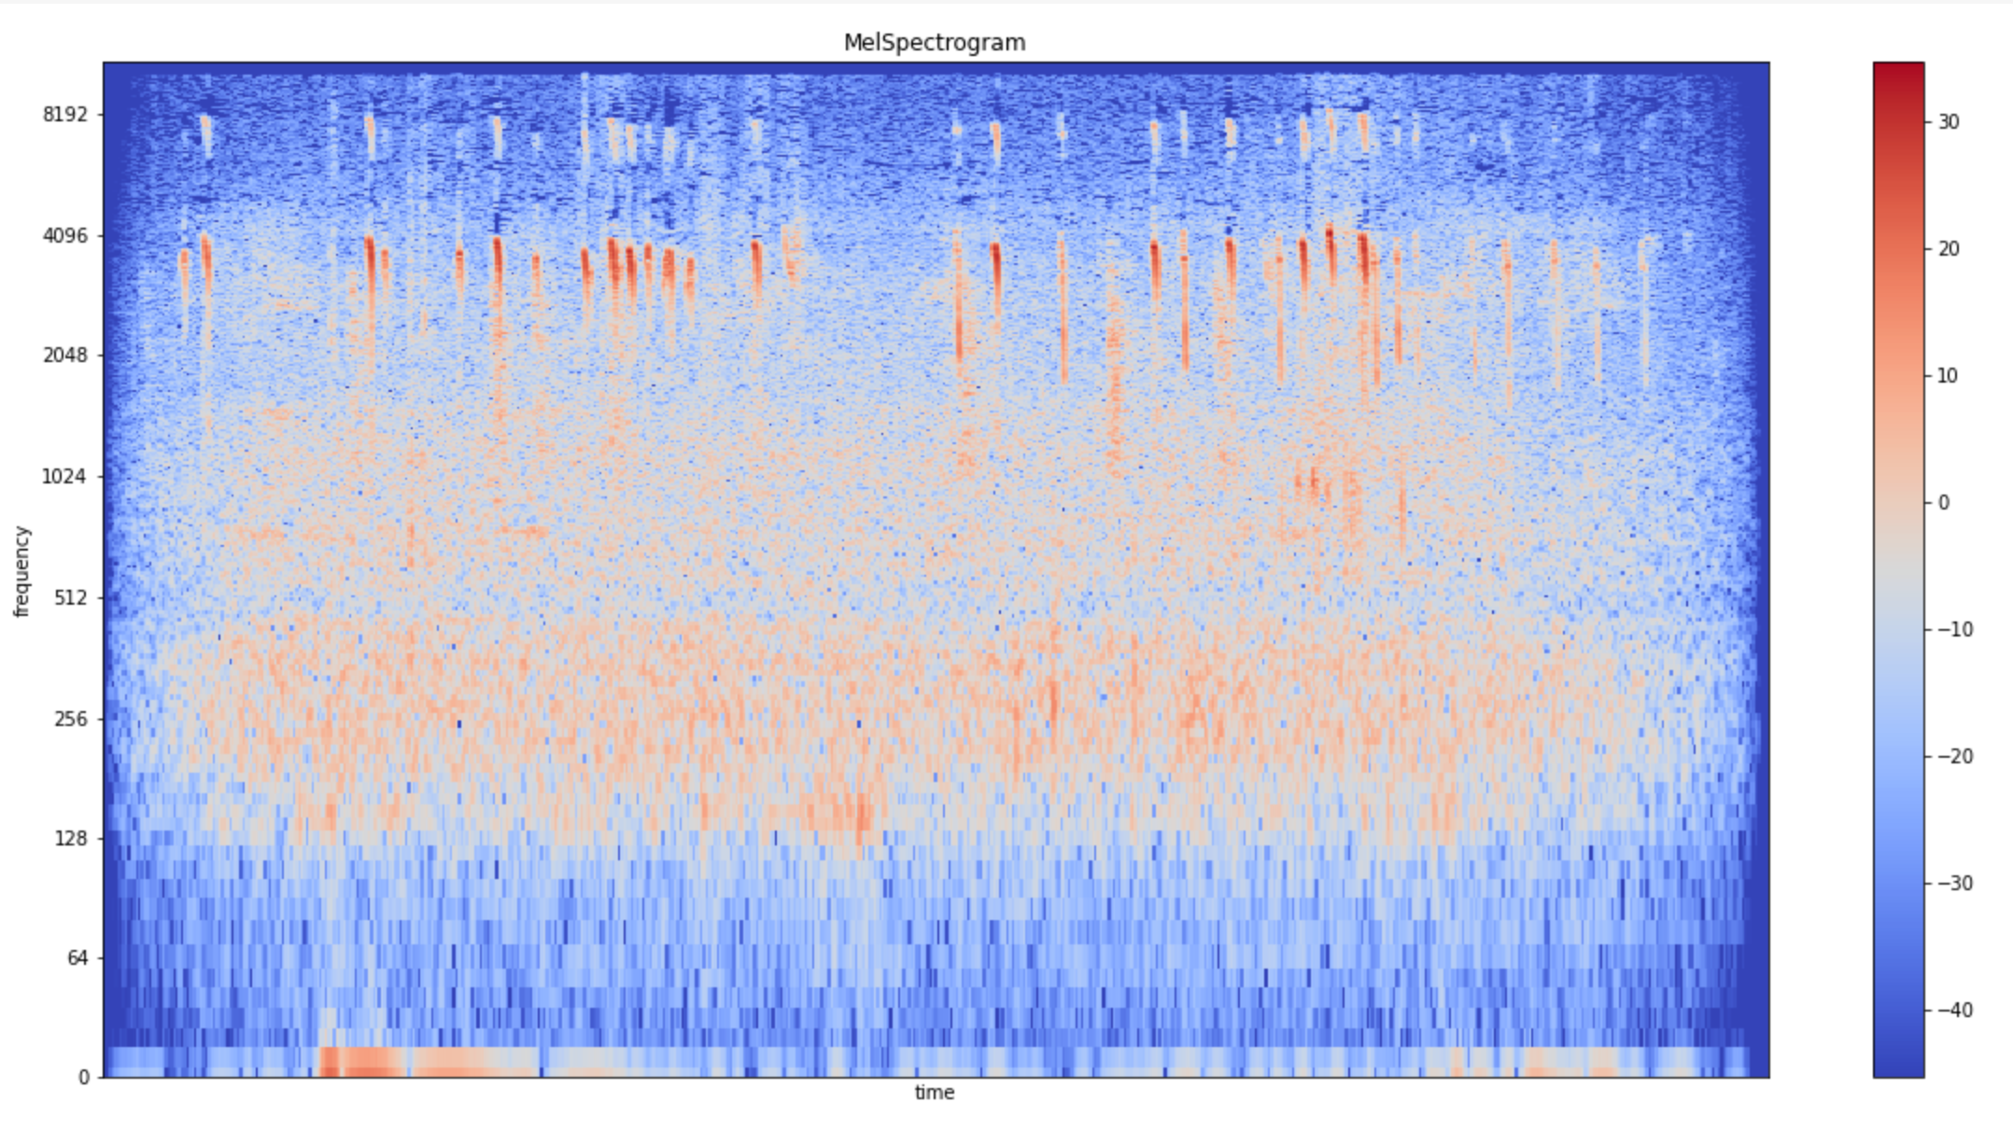
Spectrogram of input signal

Slide 4
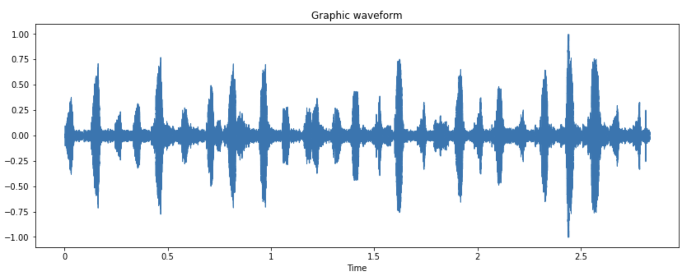
Data Cleaning
1. Removing the silent intervals
Audio:
Waveform:

Slide 5
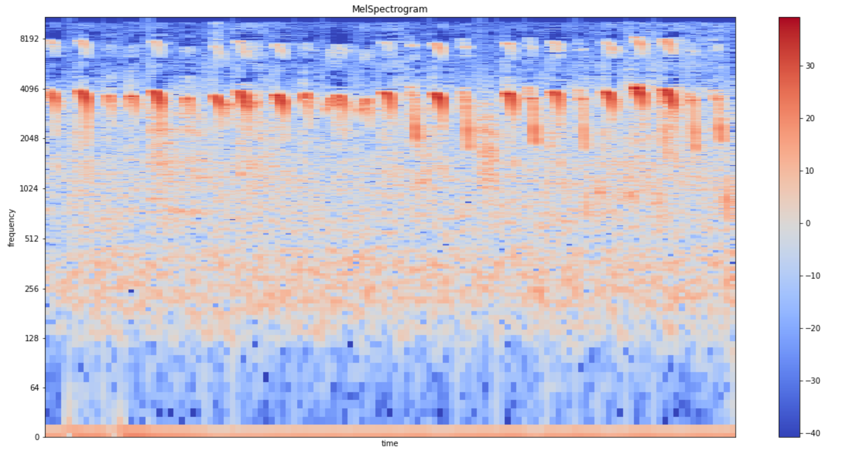
Spectrogram

Slide 6
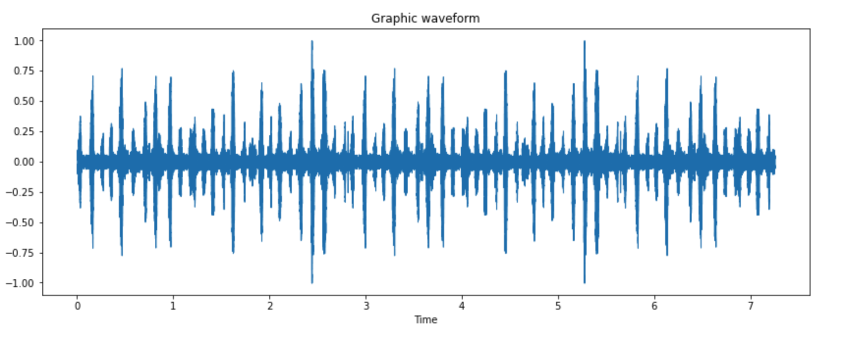
Obtaining a 5 second chunk of the video by concatenating
Waveform:
Audio:

Slide 7
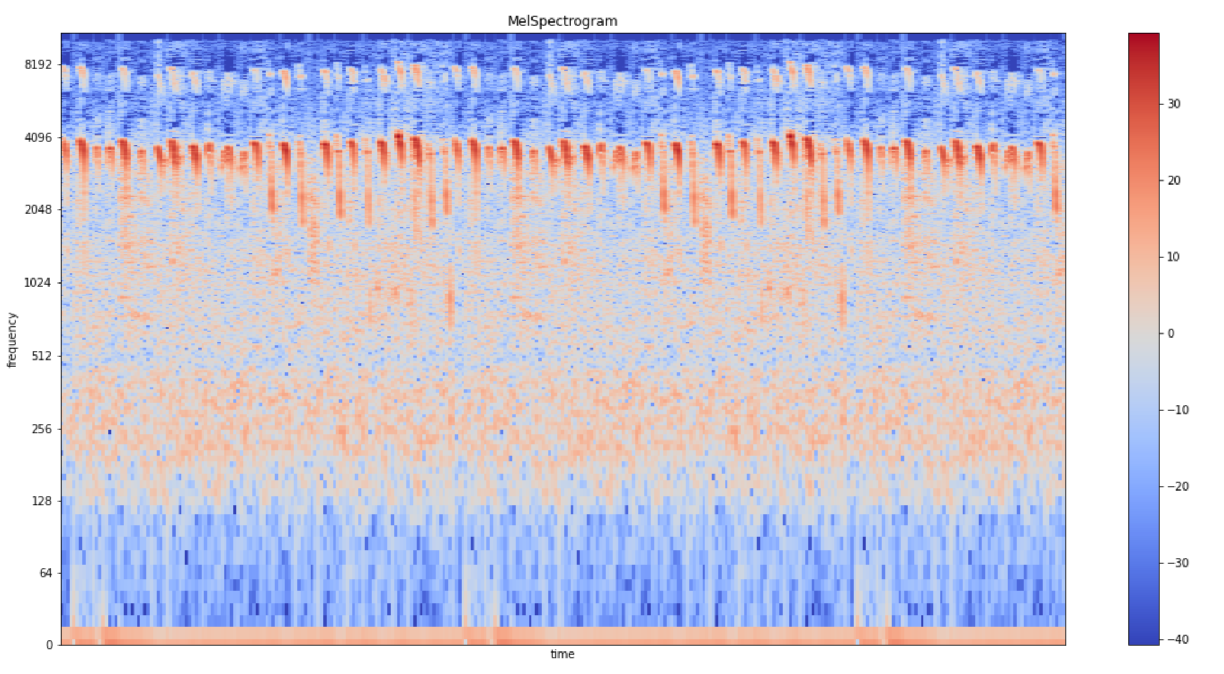
Spectrogram

Slide 8
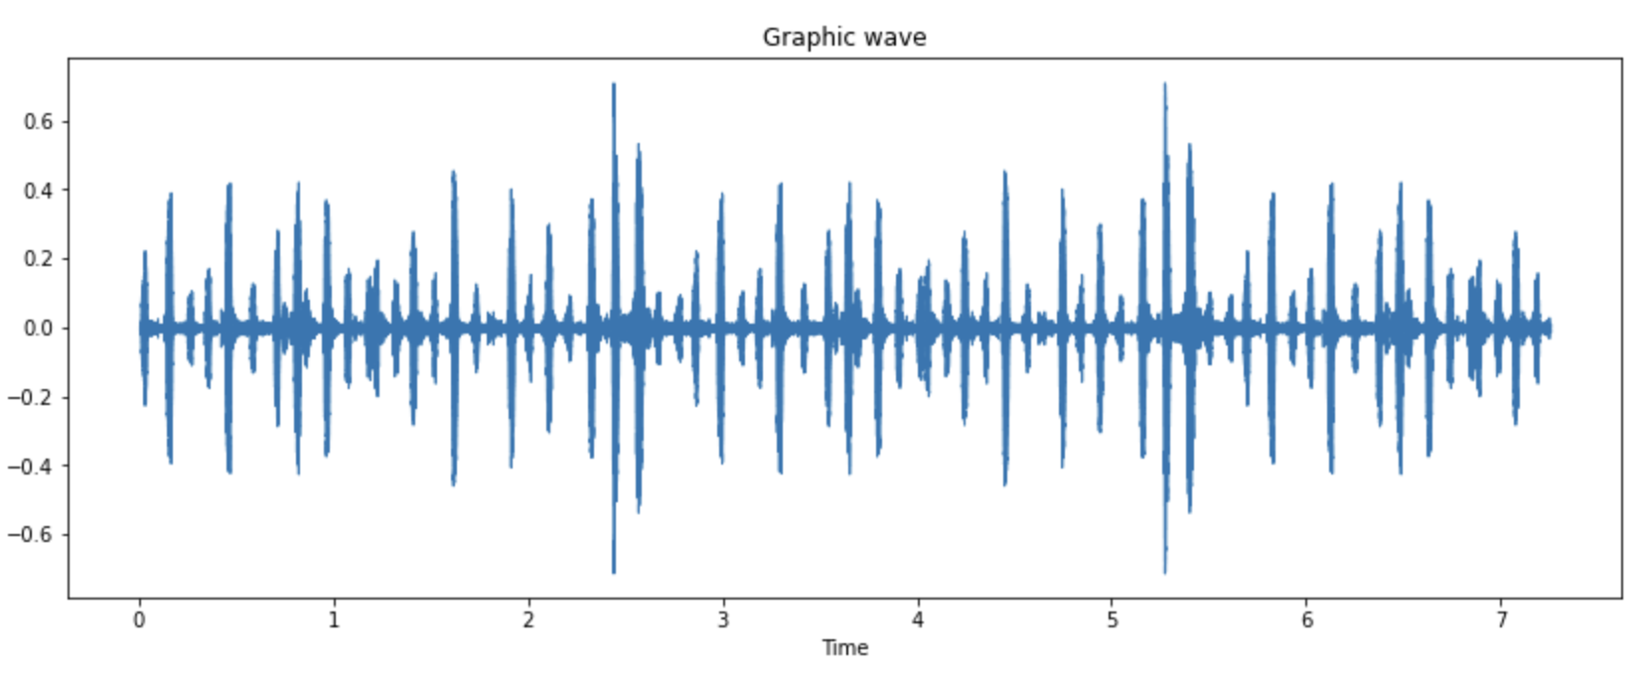
Data Cleaning
2. Filtering out low frequency noise
Waveform:
Audio:

Slide 9
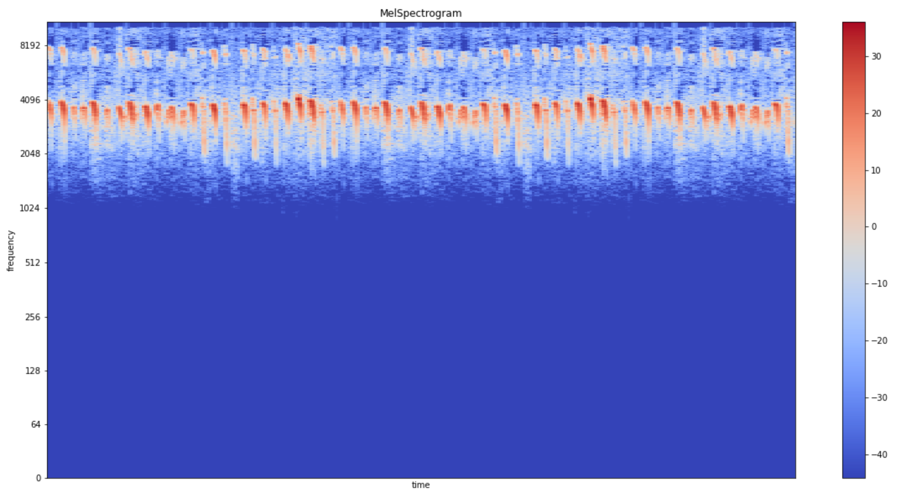
Spectrogram

